Slide 1
Blacktown Chinese Christian Church
Welcome to Our English Service 06.07.2025
English Service 9:45 – 11:00 am
Worship Songs: Passage: Speaker: Topic: Response Song: Announcements and Closing Prayer Benediction
A Thousand Hallelujahs Cornerstone Yet Not I But Through Christ in Me Hosea 1:10,11; Hosea 2:1 Jose Peter Hosea TBA

Slide 2
BCCC english service

Slide 3

Please keep all phones on silent

Slide 4
A Thousand Hallelujahs
CCLI Licence No: 5485849

Slide 5
Who else would rocks cry out to worship?
Whose glory taught the stars to shine?
Perhaps creation longs to have the words to sing
But this joy is mine

Slide 6
With a thousand hallelujahs
We magnify Your name
You alone deserve the glory
The honor and the praise

Slide 7
Lord Jesus
This song is forever Yours
A thousand hallelujahs
And a thousand more

Slide 8
Who else would die for our redemption?
Whose resurrection means I’ll rise?
There isn’t time enough to sing of all You’ve done
But I have eternity to try

Slide 9
With a thousand hallelujahs
We magnify Your name
You alone deserve the glory
The honor and the praise

Slide 10
Lord Jesus
This song is forever Yours
A thousand hallelujahs
And a thousand more

Slide 11
Praise to the Lord
To the lamb
To the King of Heaven

Slide 12
Praise for He rose
Now He reigns
We will sing forever

Slide 13
Praise to the Lord
To the lamb
To the King of Heaven

Slide 14
Praise for He rose
Now He reigns
We will sing forever

Slide 15
With a thousand hallelujahs
We magnify Your name
You alone deserve the glory
The honor and the praise

Slide 16
Lord Jesus
This song is forever Yours
A thousand hallelujahs
And a thousand more

Slide 17
Praise to the Lord
To the lamb
To the King of Heaven

Slide 18
Praise for He rose
Now He reigns
We will sing forever

Slide 19
With a thousand hallelujahs
We magnify Your name
You alone deserve the glory
The honor and the praise

Slide 20
Lord Jesus
This song is forever Yours
A thousand hallelujahs
And a thousand more

Slide 21
Cornerstone
CCLI Licence No: 5485849

Slide 22
My hope is built on nothing less
Than Jesus blood and righteousness
I dare not trust the sweetest frame
But wholly trust in Jesus name (x2)

Slide 23
Christ alone, Cornerstone
Weak made strong in the Saviour's love
Through the storm, He is Lord
Lord of all

Slide 24
When darkness seems to hide His face
I rest on His unchanging grace

Slide 25
In every high and stormy gale
My anchor holds within the veil
My anchor holds within the veil

Slide 26
Christ alone, Cornerstone
Weak made strong in the Saviour's love
Through the storm, He is Lord
Lord of all

Slide 27
He is Lord, Lord of all

Slide 28
Christ alone, Cornerstone
Weak made strong in the Saviour's love
Through the storm, He is Lord
Lord of all

Slide 29
When He shall come with trumpet sound
Oh may I then in Him be found
Dressed in His righteousness alone
Faultless stand before the throne

Slide 30
Christ alone, Cornerstone
Weak made strong in the Saviour's love

Slide 31
Through the storm, He is Lord
Lord of all
He is Lord, Lord of all

Slide 32
Christ alone, Cornerstone
Weak made strong in the Saviour's love

Slide 33
Through the storm, He is Lord
Lord of all
He is Lord, Lord of all

Slide 34
Yet Not I But Through Christ In Me
CCLI Licence No: 5485849

Slide 35
What gift of grace is Jesus, my Redeemer
There is no more for heaven now to give
He is my joy, my righteousness and freedom
My steadfast love, my deep and boundless peace

Slide 36
To this I hold, my hope is only Jesus
For my life is wholly bound to His
Oh how strange and divine, I can sing "All is mine"
Yet not I, but through Christ in me

Slide 37
The night is dark but I am not forsaken
For by my side, the Savior He will stay
I labour on in weakness and rejoicing
For in my need, His power is displayed

Slide 38
To this I hold, my Shepherd will defend me
Through the deepest valley He will lead
Oh the night has been won and I shall overcome
Yet not I, but through Christ in me

Slide 39
No fate I dread, I know I am forgiven
The future sure, the price it has been paid
For Jesus bled and suffered for my pardon
And He was raised to overthrow the grave

Slide 40
To this I hold, my sin has been defeated
Jesus now and ever is my plea
All the chains are released, I can sing "I am free"
Yet not I, but through Christ in me

Slide 41
With every breath, I long to follow Jesus
For He has said that He will bring me home
And day by day, I know He will renew me
Until I stand with joy before the throne

Slide 42
To this I hold, my hope is only Jesus
All the glory evermore to Him
When the race is complete, still my lips shall repeat
"Yet not I, but through Christ in me"

Slide 43
When the race is complete, still my lips shall repeat
"Yet not I, but through Christ in me"
"Yet not I, but through Christ in me"
"Yet not I, but through Christ in me"

Slide 44
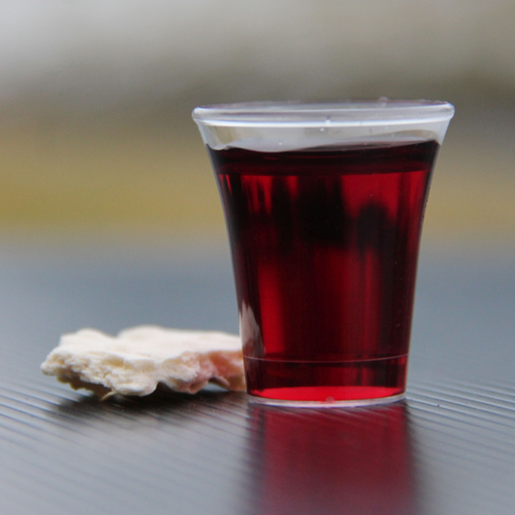
Holy Communion

Slide 45
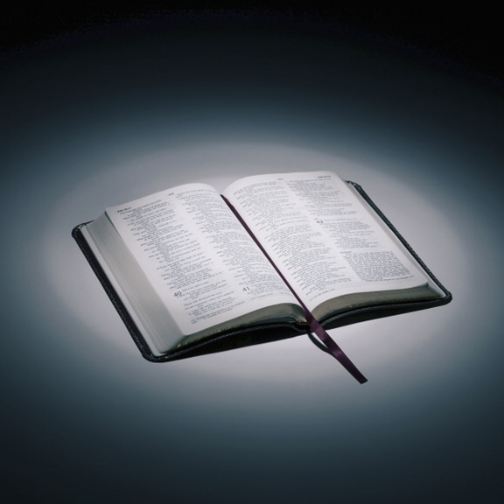
Bible reading

Slide 46
Hosea 1:10,11; Hosea 2:1
¹⁰ “Yet the Israelites will be like the sand on the seashore, which cannot be measured or counted. In the place where it was said to them, ‘You are not my people,’ they will be called ‘children of the living God.’
¹¹ The people of Judah and the people of Israel will come together; they will appoint one leader and will come up out of the land, for great will be the day of Jezreel.
“Say of your brothers, ‘My people,’ and of your sisters, ‘My loved one.’

Slide 47
Announcements

Slide 48





Account name: Blacktown Chinese Christian Church
Account number: 4216 50263
Offering
BSB: 112 - 879
Please put in "offering" as the reference
The offering box is available at the back of the hall

Slide 49
Prayer points

Slide 50
Mingle time!

